Slide 1

Vidyavardhaka College of Engineering, Mysuru
Autonomous Institute, Affiliated to VTU
Accredited by NBA | NAAC with ‘A’ Grade
Social Innovation Lab [BSOIK208]
Academic Year 2023-2024
A Project Presentation on
“RESILIENCE HUB : A CrowdSourced Crisis Management Platform”
Presented by
Aadya.M.Bhat [4VV23CS001]
Abhishek.N[4VV23CS004]
Abu Safwan[4VV23CS006]
Akshay Sujan[4VV23CS016]
Ananya M S[4VV23CS020]
Afreen[4VV23CS012]
Under the Guidance of
Dr. N SANDHYA RANI
Assistant Professor
Department of Physics
VVCE, Mysuru

Slide 2

CONTENTS
 | TOPIC
01. | CRISIS MANAGEMENT : WHAT AND WHY?
02. | RESILIENCE HUB : A CROWDSOURCED CRISIS MANAGEMENT PLATFORM
03. | OBJECTIVES AND KEY FEATURES
04. | USER INTERFACE
05. | APPLICATIONS
06. | CHALLENGES ASSOCIATED
07. | FUTURE SCOPE AND DEVELOPMENT
08. | CONCLUSION AND REFERENCE

Slide 3

WHAT IS CRISIS MANAGEMENT
CRISIS MANAGEMENT : Handling unforeseen events effectively.
Proactive Planning
Response Coordination
Recovery Strategies
Risk Assessment
Communication
Business Continuity
Learning & Adaptation

Slide 4

.
WHY CRISIS MANAGEMENT?
Preparedness
Risk Mitigation
Response Coordination
Resource Allocation
Reputation Protection
Lives and Property
Business Continuity
Community Resilience

Slide 5

RESILIENCE HUB : A CROWDSOURCED CRISIS MANAGEGEMENT PLATFORM
Overview: Centralized hub for crisis communication.
Purpose: Address challenges in crisis management.
Functionality: Real-time updates and collaborative tools.
User-Friendly Interface: Intuitive design for easy navigation.
Mission: Enhance preparedness and community safety.

Slide 6

OBJECTIVES AND KEY FEATURES
Address crisis challenges.
Improve preparedness.
Enhance community safety.
Real-time communication.
Resource coordination.
Collaborative tools for safety tips and emergency contacts.

Slide 7
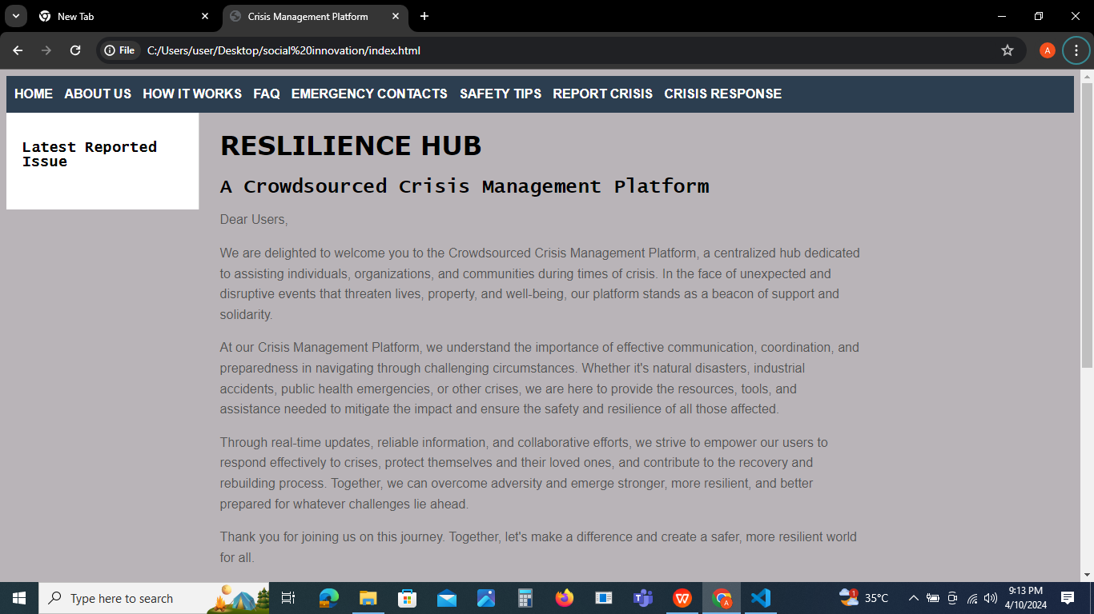
USER INTERFACE
User-friendly navigation and Intuitive design.

Slide 8
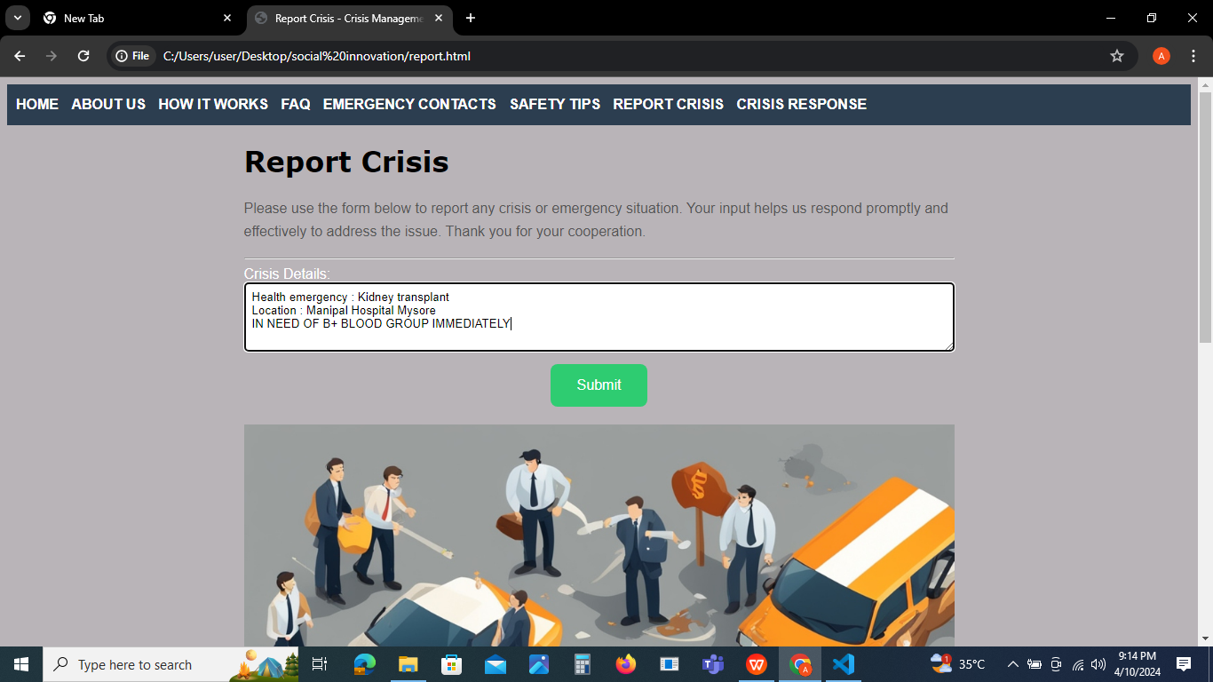

Slide 9
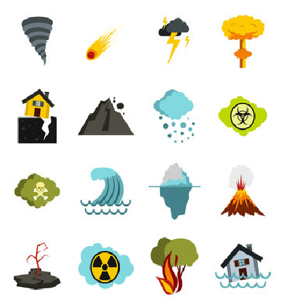
APPLICATIONS
Natural Disasters
Public Health Emergencies
Industrial Accidents
Cybersecurity Incidents
Terrorism and Security Threats
Environmental Crises
Financial Crises
Social Unrest or Humanitarian crisis

Slide 10

CHALLENGES ASSOCIATED
User Engagement
Data Security and authentication
Scalability Issues
Technical Glitches
Accessibility Concerns
Resource Constraints
Regulatory Compliance
Communication Bottlenecks
User Training

Slide 11

FUTURE SCOPE AND DEVELOPMENT
Expansion Plans
Tech Integration
Partnerships
Mobile Apps
Predictive Models
Community Involvement
Training Modules
Global Outreach
Innovation Drive
R&D Initiatives

Slide 12

CONCLUSION
Our website endeavors to harness the potential of technology, engage youth participation, and foster collaborative initiatives to fortify community safety and security, thereby contributing to the collective resilience and well-being of society.

Slide 13
REFERENCES
BOOK : "The Resilient City: How Modern Cities Recover from Disaster" by Lawrence J. Vale and Thomas J. Campanella
WEBSITE : Federal Emergency Management Agency (FEMA) - www.fema.gov
MAGAZINE : Journal of Emergency Management
AI TOOLS : ChatGPT - https://chat.openai.com

Slide 14


